Slide 1
UTPS Inspection Process
By Jimmy Betham

Slide 2
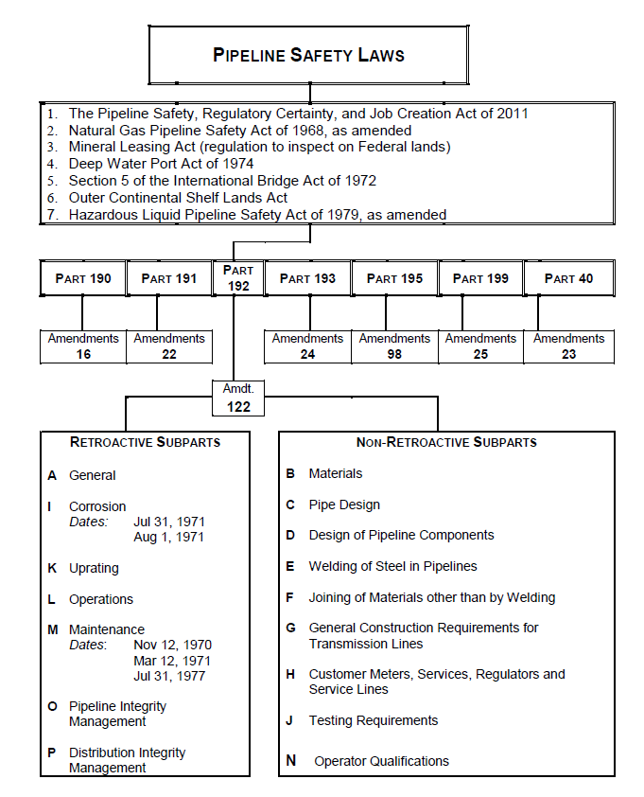

Slide 3
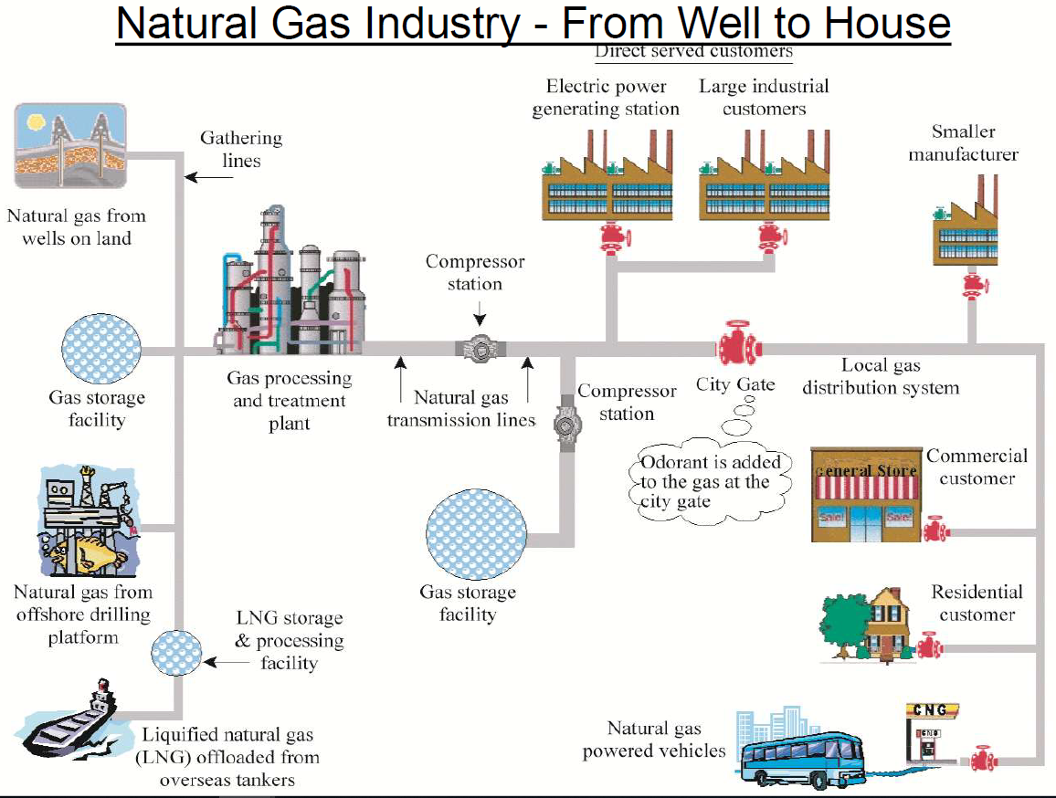

Slide 4
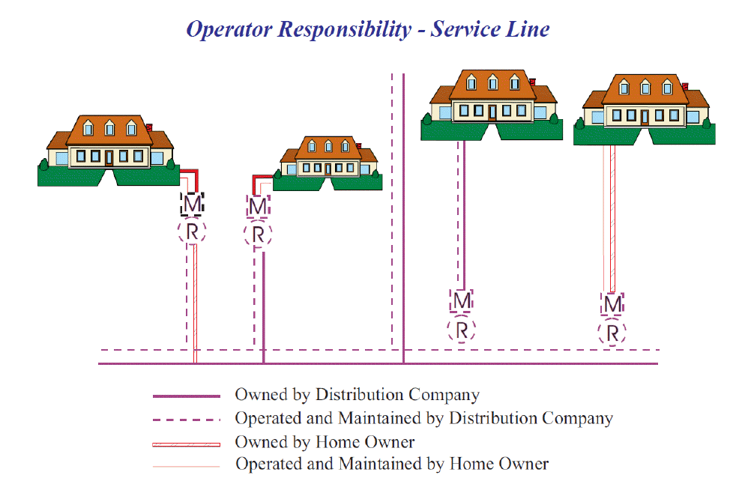

Slide 5
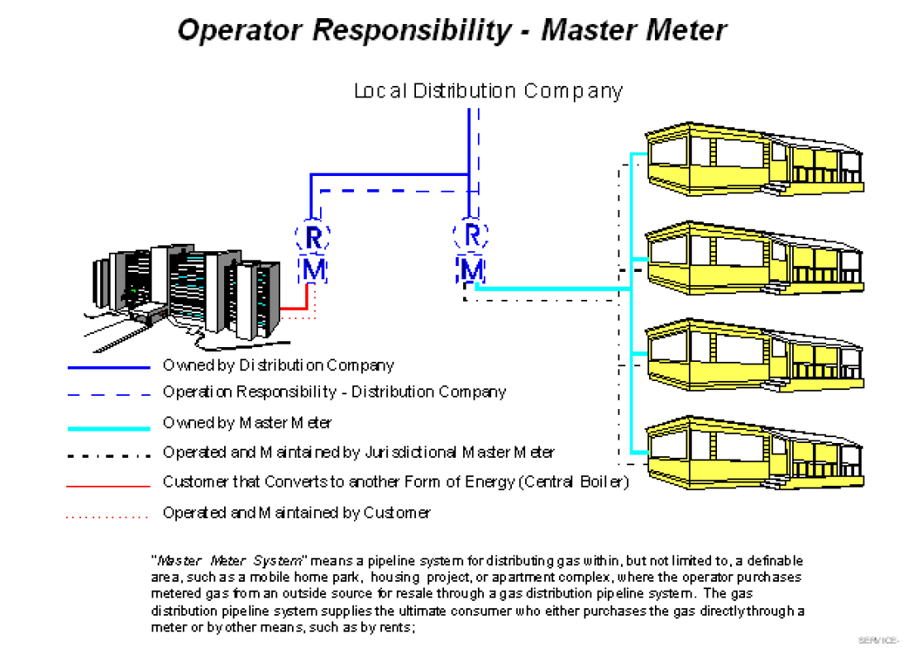

Slide 6
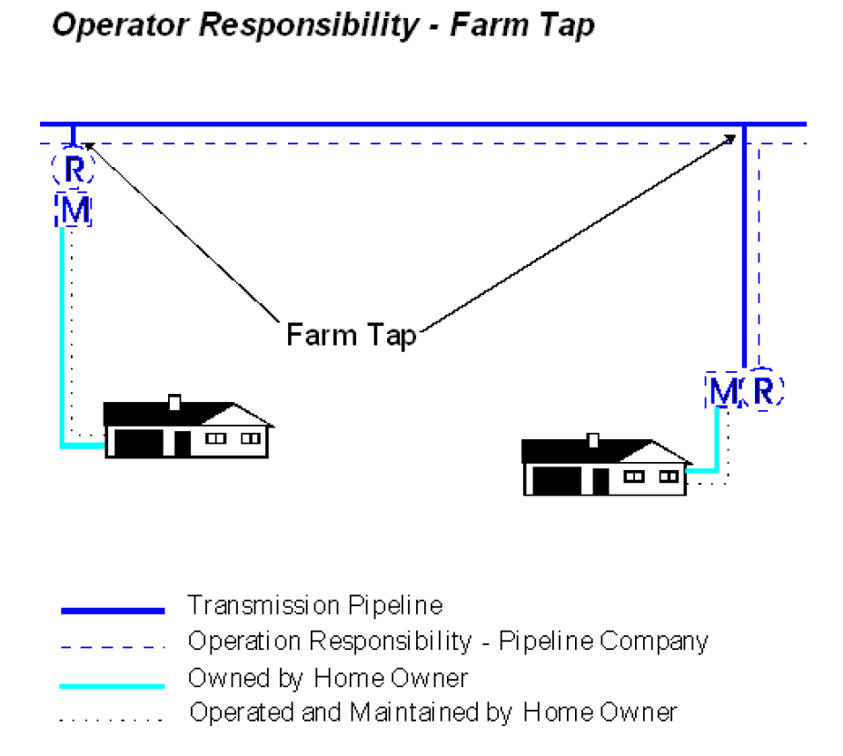

Slide 7
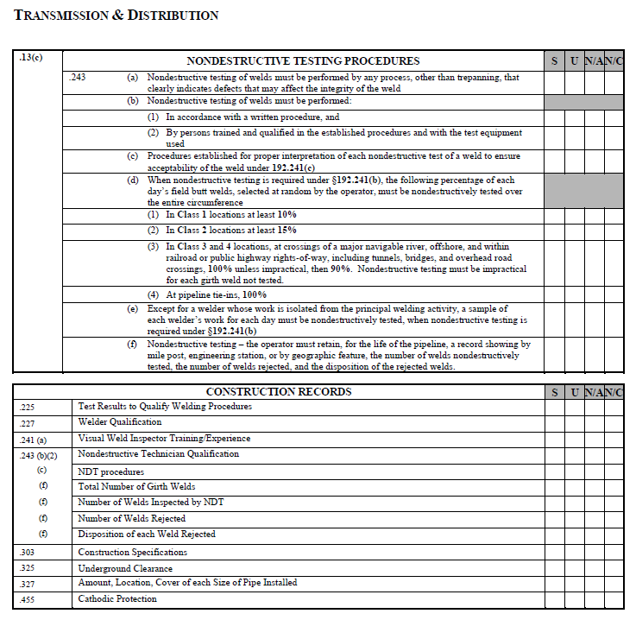

Slide 8
UTPS Inspection
Procedures
Records
Field Observation

Slide 9
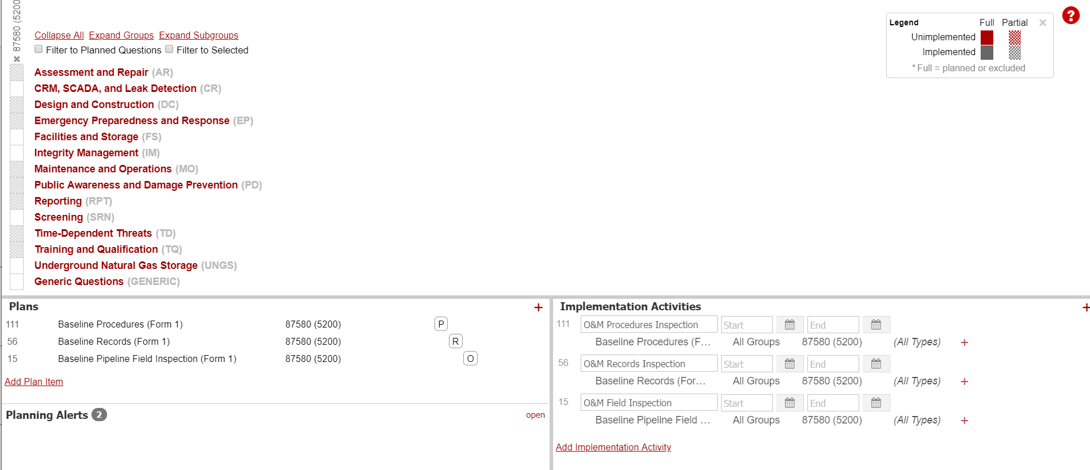

Slide 10
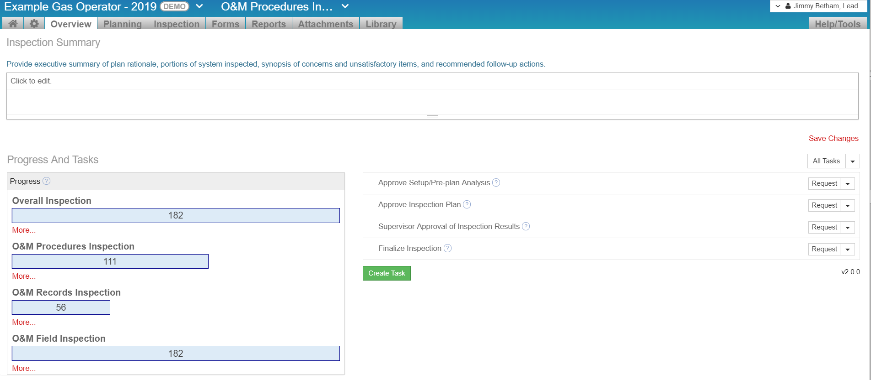

Slide 11
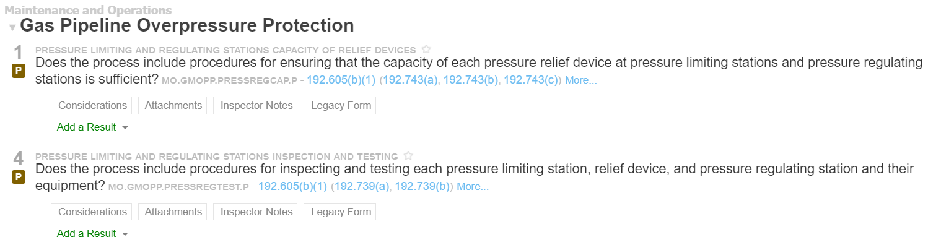
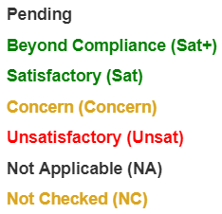

Slide 12
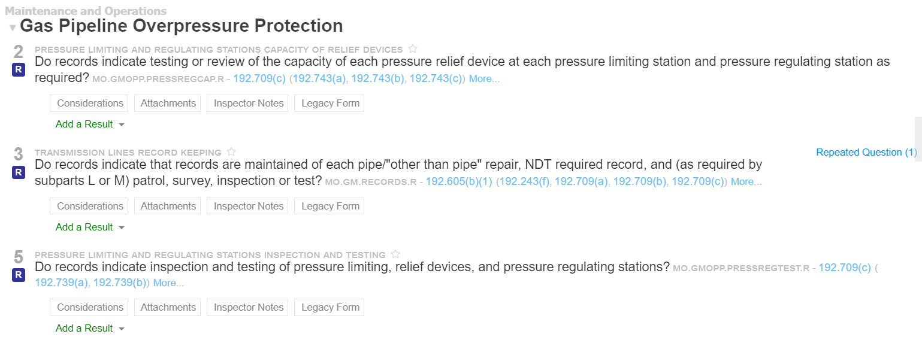

Slide 13
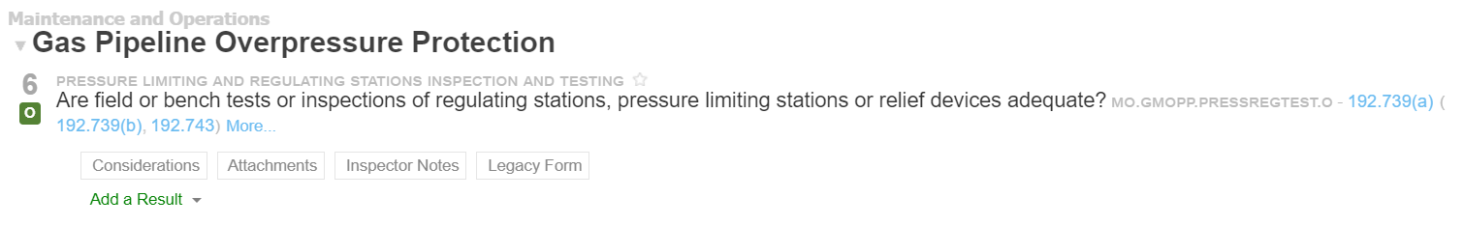

Slide 14
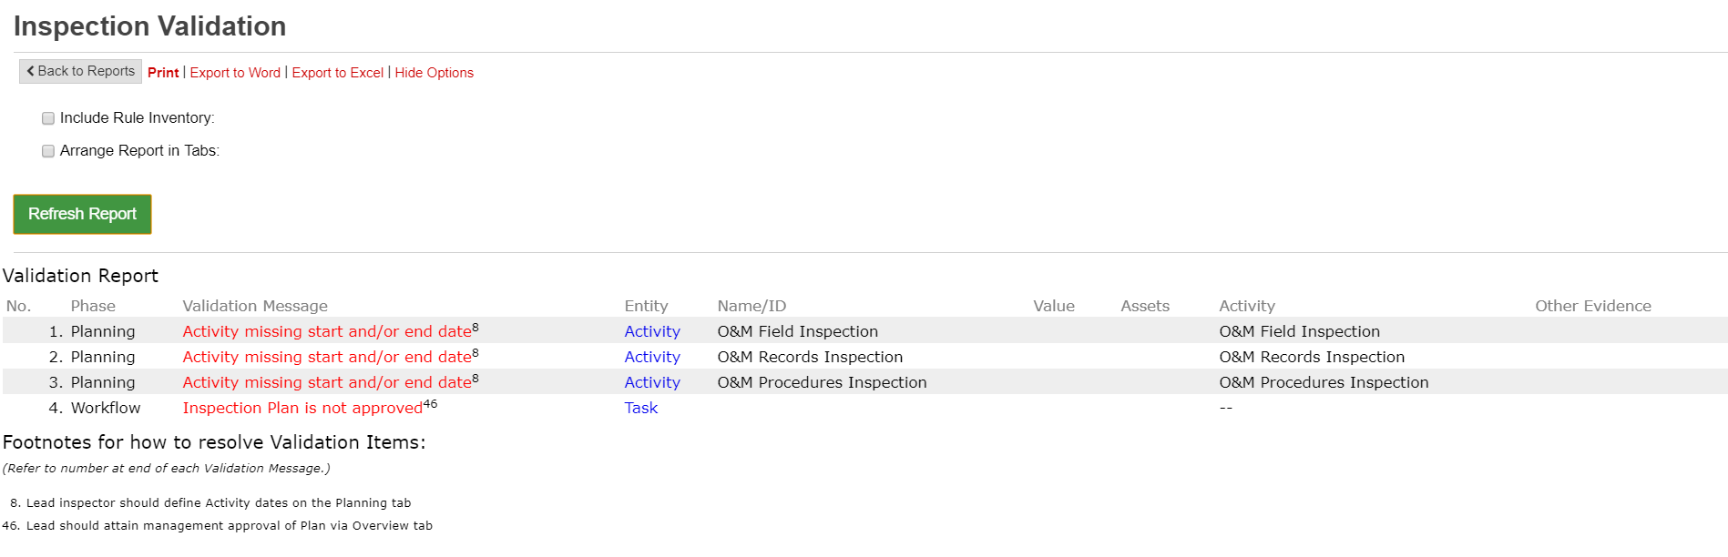

Slide 15
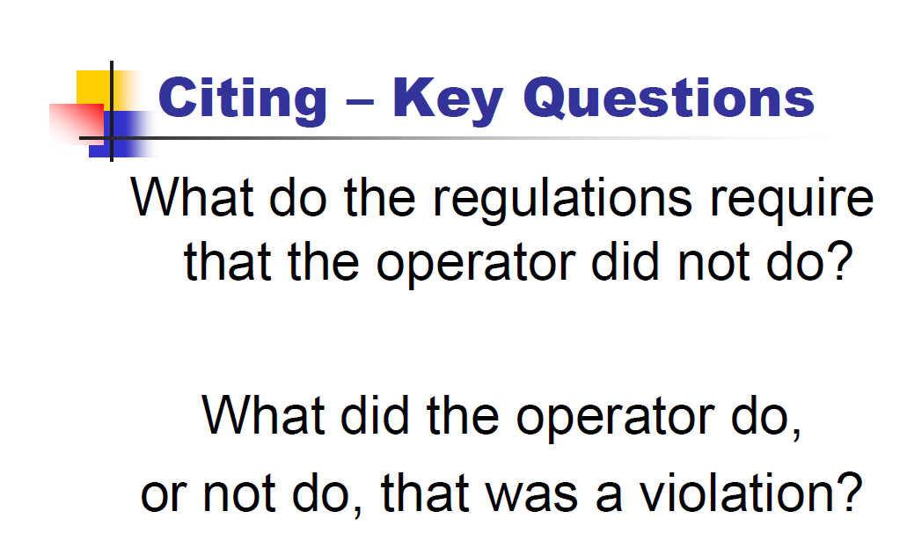

Slide 16
Close Out Letter
No Further Action
NOPV Letter
Operator Response
Close Out Letter
Follow-Up Letter
1st Warning Letter
2nd Warning Letter
AG Office Civil Penalties
Close Out Letter

Slide 17
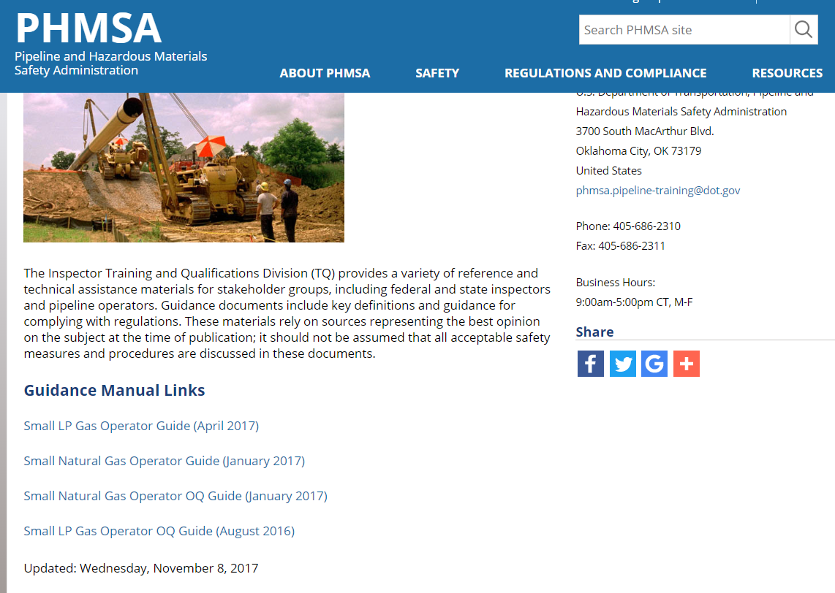
Helpful Websites
https://www.phmsa.dot.gov/training/pipeline/guidance-manuals

Slide 18
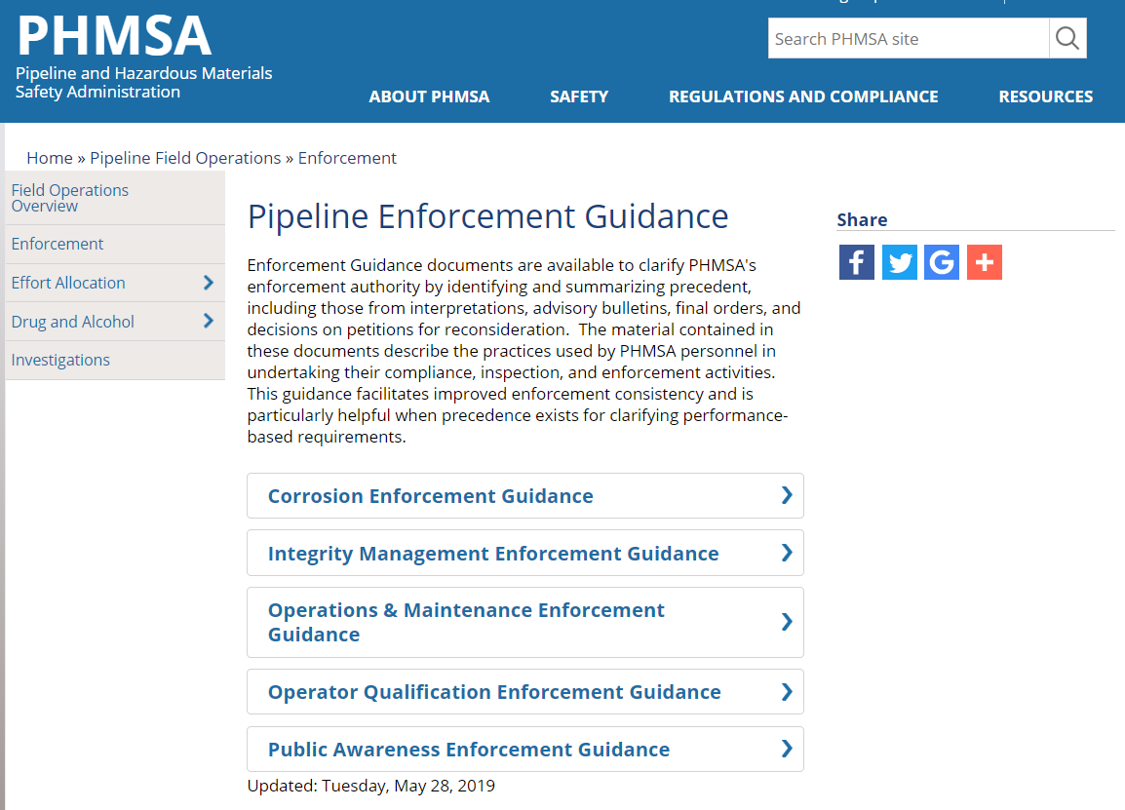
Helpful Websites
https://www.phmsa.dot.gov/pipeline/enforcement/enforcement-program-0

Slide 19
QUESTIONS?

