Slide 1

Section 113 and 114 of Pipes Act 2020
Notes:
What are we gong to talk about this morning?

Slide 2
PIPES ACT 2020
Section 113/Section 114
  Considering revisions to leak survey frequency, repairs of leak survey and the use of Advance Leak Technology
  Section 114 contains self executing provision for operators to minimize releases of natural gas and update O&M to reflect steps taken
  PHMSA is initiating a study on best available practices to minimize leaks
O&M Update - 12/27/21
Advisory Bulletin (ADB-2021-01)-Thursday, June 10, 2021

Slide 3
Section 114 of the 2020 Pipeline Safety Act

Slide 4

§60108 Inspection and maintenance
(a) PLANS. -
(1) Each person owning or operating a gas pipeline facility or hazardous liquid pipeline facility shall carry out a current written plan (including any changes) for inspection and maintenance of each facility used in the transportation and owned or operated by the person.…..

Slide 5
§ 60108 Inspection and maintenance
(2) ….. the Secretary or authority shall require the person to revise the plan. Revision may be required only after giving notice and an opportunity for a hearing.
A plan required under paragraph (1) must be practicable and designed to meet the need for pipeline safety, must meet the requirements of any regulations promulgated under section 60102(q), and must include terms designed to enhance the ability to discover safety-related conditions described in section 60102(h)(1) of this title. In deciding on the adequacy of a plan, the Secretary or authority shall consider -

Slide 6
§60108 Inspection and maintenance
In deciding on the adequacy of a plan, the Secretary or authority shall consider -
(A) relevant available pipeline safety information;
(B) the appropriateness of the plan for the particular kind of pipeline transportation or facility;
(C) the reasonableness of the plan; and
(D) the extent to which the plan will contribute to public safety and the protection of the environment.
(D) the extent to which the plan will contribute to--
(i) public safety;
(ii) eliminating hazardous leaks and minimizing releases of natural gas from pipeline facilities; and
(iii) the protection of the environment; and

Slide 7
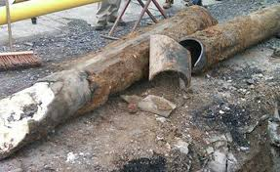
§ 60108 Inspection and maintenance
(E) the extent to which the plan addresses the replacement or remediation of pipelines that are known to leak based on the material (including cast iron, unprotected steel, wrought iron, and historic plastics with known issues), design, or past operating and maintenance history of the pipeline.

Slide 8

§60108 Inspection and maintenance
(3) A plan required under this subsection shall be made available to the Secretary or State authority on request under section 60117 of this title.
(3) Review of plans.--
(A) In general.--Not later than 2 years after the date of enactment of this subparagraph, and not less frequently than once every 5 years thereafter, the Secretary or relevant State authority with a certification in effect under section 60105 shall review each plan described in this subsection.
……

Slide 9
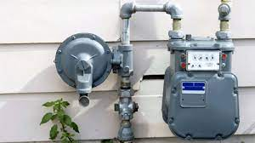
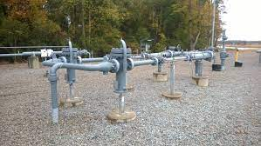
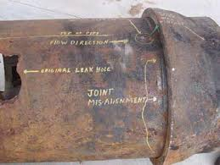
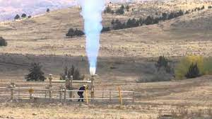
Section 114 Inspection Questions
Gas Distribution & Master Meters

Slide 10
12 Questions
Subject Areas
Leaks/Releases
Leaks
Regulator Stations
Testing – Relief Valves
Flaring
General

Slide 11
THANK YOU!
Lane Miller
202-924-5370
lane.miller@dot.gov

